Slide 1
WNTA LUBNA SAYED QADRI NATIONAL CAMPAIGN COORDINATOR

Slide 2
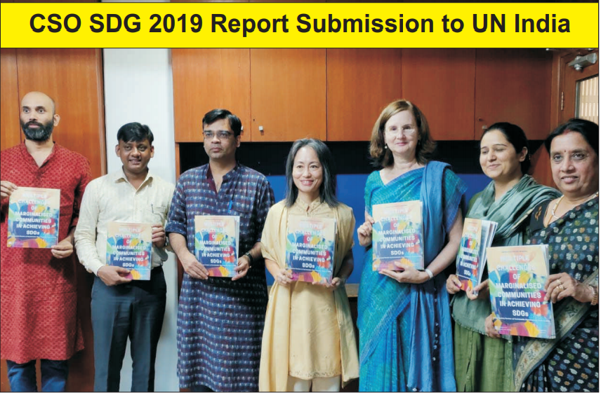

Slide 3
LNOB:100 Hotspots Study

Slide 4
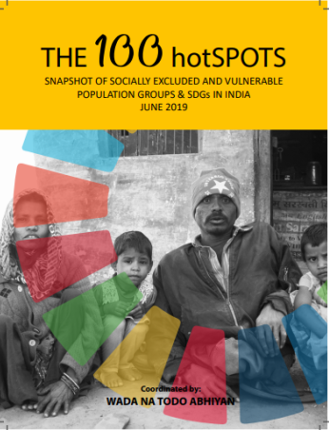

Slide 6
INDIA VNR 2020 CSO-ENGAGEMENT

Slide 7
INDIA’s VNR IN 2020 – ACTION PLAN
VNR REPORT
Central Ministries
State/ UT governments
CSOs, academia, think tanks
Main Message
Private sector
Video
Research
Input
Output
Communications

Slide 8
Vulnerable Groups Identified by NITI
1. Dalits
2. Adivasis
3. Nomadic and Denotified Tribes
4. Elderly
5. Youth & Adolescents
6. Children
7. Women
8. Transgender & LGBTQI
9. Farmers
10. Bonded labour and victims of human trafficking
11. Persons with disability
12. Migrants and urban poor
13. People living with HIV-AIDS
ADDITIONAL STAND-ALONE CSO - CONSULTATIONS:
14. Refugees
15. Religious Minorities
16. North-East

Slide 9
OUTCOME DOCUMENT – TENTATIVE FORMAT
Concise report to be prepared for each consultation highlighting-
Methodology and process of review
Status of SDG progress
How the government has addressed the integrated and indivisible nature of the SDGs and to the principle of “leaving no one behind”?
Two or three examples of each of the following: good practices, lessons learnt, challenges encountered, and emerging issues
Two or three support areas, for instance, capacity building, technology, partnerships, real-time data etc. with implementable ideas

